Slide 1
Social Media Friend Recommendation Simulator
Data Structures And Algorithm Lab Project
Presented By:
Hassan Ali Ahmad (NUM-BSEE-2023-03)
Abdul Rehman (NUM-BSEE-2023-36)
Muqaddas Bibi (NUM-BSEE-2022-18)
Lab Instructor: Ms. Sana Parveen

Slide 2
Outline
Introduction
Flow Diagram
Project Overview
System Architecture
Data Structures Algorithms
User Class Logic
Friend Request Algorithm
Friend Suggestion Algorithm
Messaging Algorithm
Conclusion
References

Slide 3
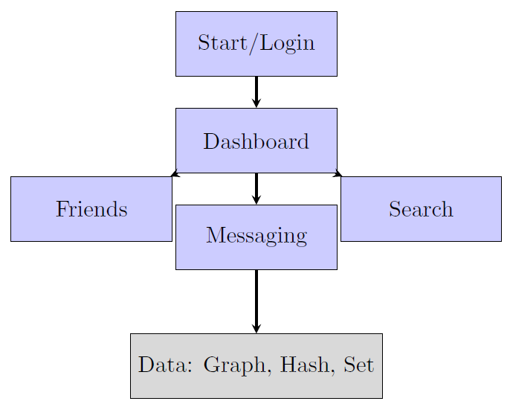
Project Flow Diagram

Slide 4
Project Overview
This project simulates a social networking system
Users can send and accept friend requests
Messaging feature supports text and images
Profile pictures and profile updates are included
Core focus is implementation of DSA concepts

Slide 5
System Architecture
Frontend: HTML
Backend: Flask (Python Framework)
Data Storage: JSON file (persistent storage)
File Uploads: Profile pictures & message images
Authentication: Session-based login system

Slide 6
Data Structures Algorithms
Graph: Represents friendship network
Hash Table (Dictionary): Stores users efficiently
Set: Friends list (avoids duplicates)
List: Friend requests and messages
BFS Concept: Friend suggestions

Slide 7
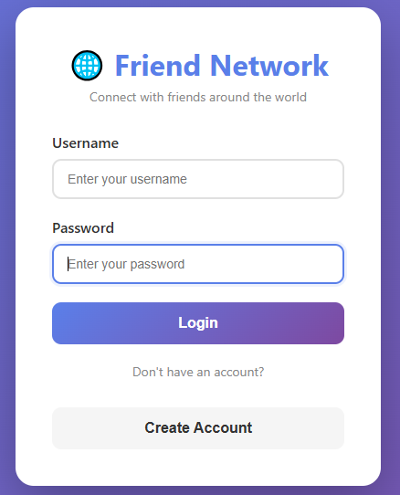
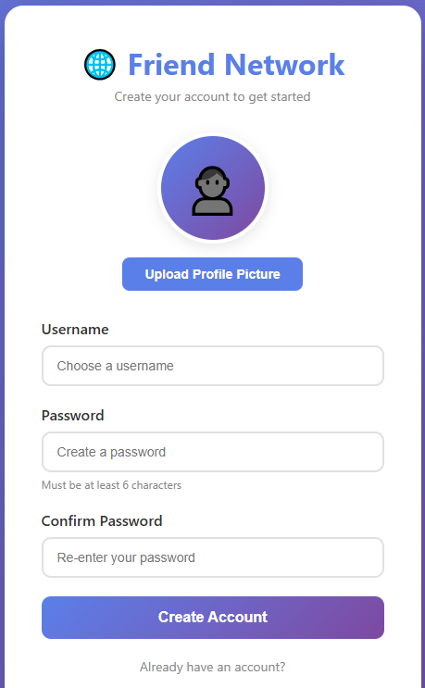
User Class Logic
User Login
User Registration
Stores username and hashed
password
Profile picture support added
Pending and sent requests stored
in LIST
Data converted to dictionary for
JSON storage
Friends stored using SET

Slide 8
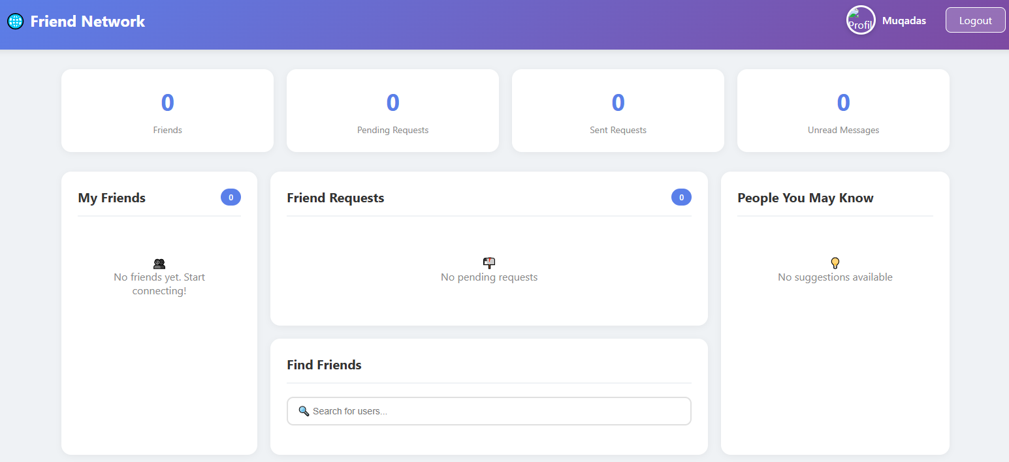
User Dashboard

Slide 9
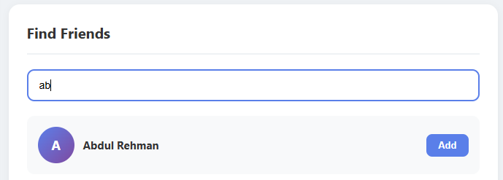
Friend Request Algorithm
Check if receiver exists
Prevent sending request to self
Avoid duplicate requests
Store request in pending and sent lists
On accept, update graph edges

Slide 10
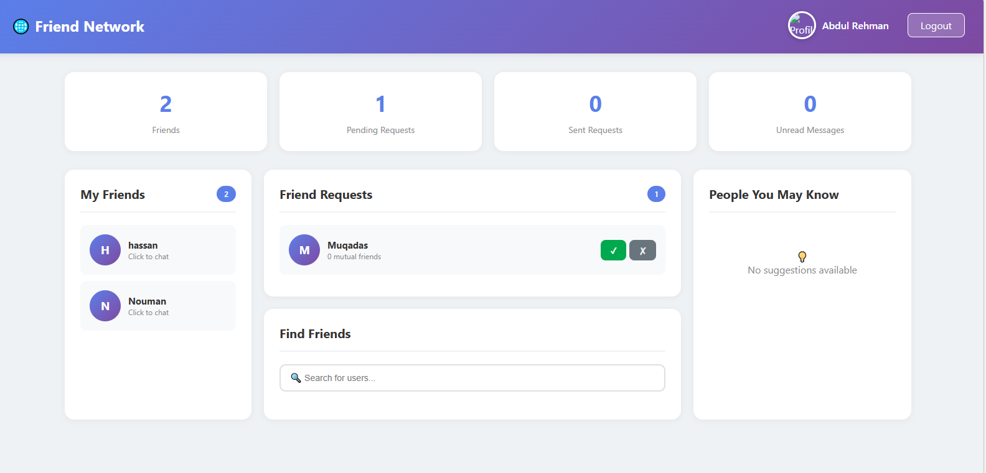
Friend Request Algorithm

Slide 11
Friend Suggestion Algorithm
Based on Friends-of-Friends concept
Uses BFS like traversal
Excludes existing friends and pending users
Counts mutual friends
Sorts suggestions by mutual friend count

Slide 12
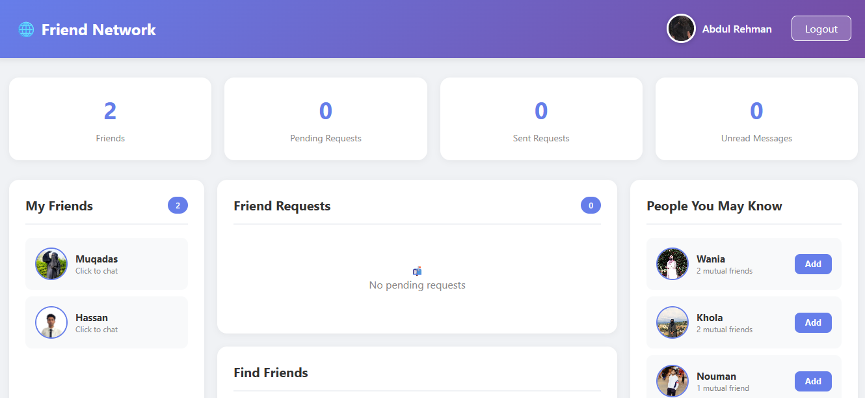
User Dashboard

Slide 13
Messaging Algorithm
Messaging allowed only between friends
Messages stored in a list
Indexed by sender and receiver
Conversation sorted by timestamp
Unread messages tracked and updated

Slide 14
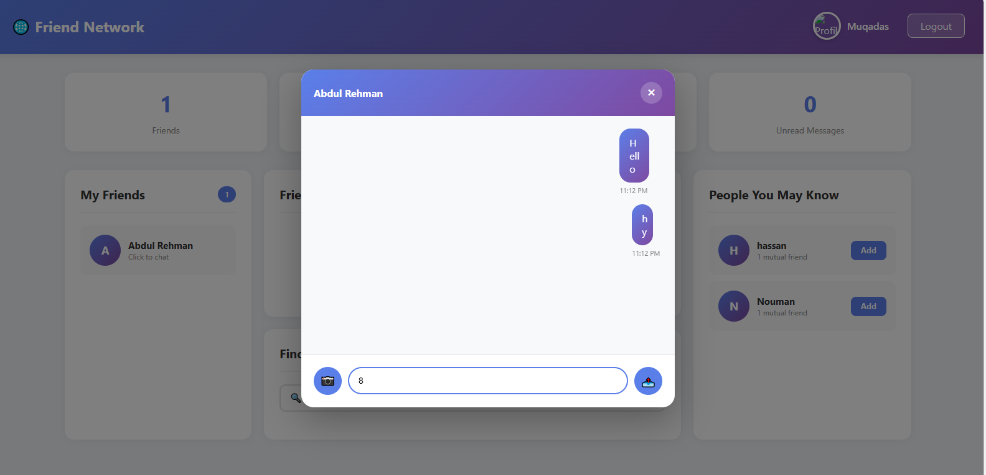
Messaging Algorithm

Slide 15
Conclusion
This project demonstrates the practical use of Data Structures and Algorithms in a social networking system. Graphs are used to manage friendships, while hash tables and sets ensure fast and consistent data handling. Flow diagrams clearly explain the system working. The integration of friend requests, messaging, and profile management makes this project good.

Slide 16
Thank You

Slide 17
References
https://chatgpt.com/
https://claude.ai/new

